Slide 1
Web3-based Privacy-Enhanced AI Chatbot Framework with Clio-X Integration
A comprehensive study on designing and implementing a privacy-preserving AI chatbot framework integrated with Clio-X in a Web3 environment.
2025.07.19
TEAM: PowerBlock

Slide 2


Background & Motivation
The acceleration of digital transformation post COVID-19 has highlighted the need for privacy-preserving AI solutions.
Web3 environments emphasize decentralized control and self-sovereign identity (SSI). Increasing demand for AI chatbots that guarantee data privacy in Web3-native architectures.
Privacy-preserving solutions are becoming critical in the expanding Web3 ecosystem

Slide 3
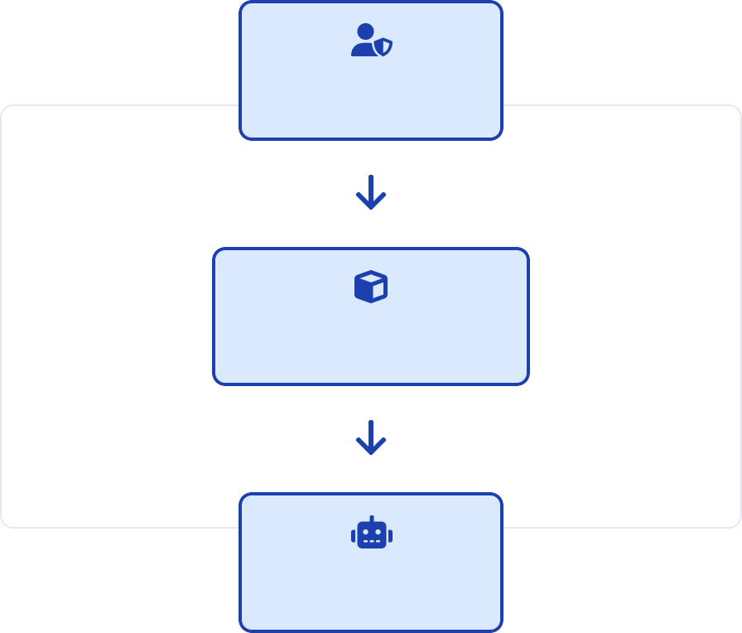

Clio-X Platform & Self-Sovereign Identity (SSI)
Clio-X: A core Web3 platform enabling decentralized data management, user authentication, and ownership validation on the blockchain.
User (SSI)
Users gain full control over data through Self-Sovereign Identity (SSI).
Critical role in supporting privacy and user-driven data in Web3 services.
Clio-X Platform
"Clio-X operates as the trust layer between blockchain data verification and AI processing, ensuring only user-approved data enters the AI pipeline."
AI Chatbot

Slide 4
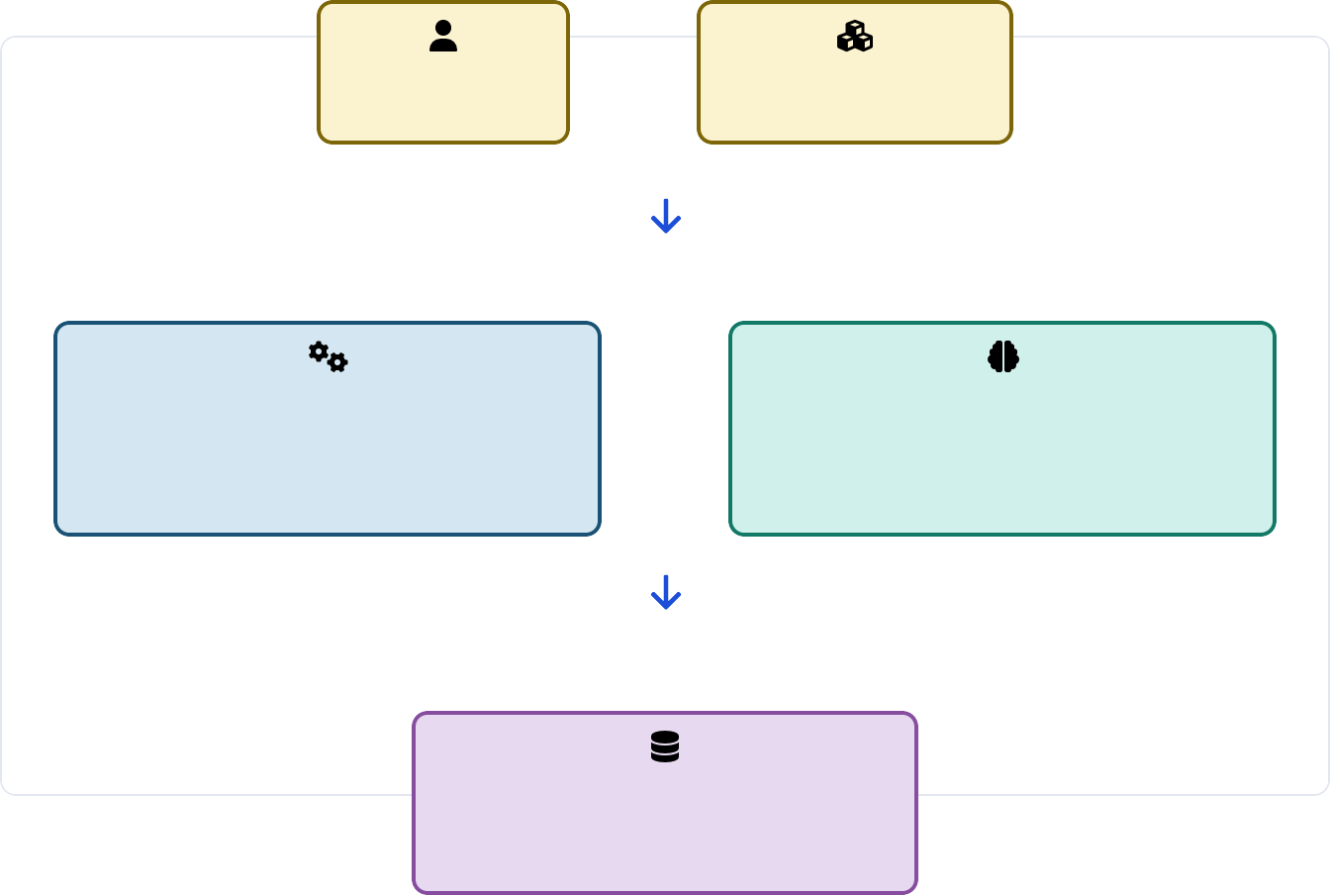

System Architecture Overview
System Architecture Overview
→
Algorithm Service: Python 3.11-slim Docker container with secure data handling via isolated volumes
(/data/inputs and /data/outputs).
User
Clio-X Platform
Ollama LLM Server: External independent service operating as a binary on the host machine, ensuring clear trust boundary separation.
Verified Data
Algorithm Service
(Python 3.11-slim Docker)
/data/inputs & /data/outputs
↔
Ollama LLM Server
(External Binary) Independent Trust Boundary
Data Flow Control: Only verified data from Clio-X is processed, maintaining Web3-native security principles.
"The architecture creates clear trust boundaries between the AI processing components and Web3 authentication, ensuring privacy by design."
Processed Results
/data/outputs/result.json

Slide 5



Technical Implementation Details
Docker Container
(Python 3.11-slim)
Algorithm service runs in Python 3.11-slim Docker container; utilizes /data/inputs
and /data/outputs volumes linked to Clio-X.
spaCy NER
Privacy Protection
FAISS-based similarity search with sentence-transformers all-MiniLM-L6-v2 for context retrieval and question processing.
Results are exported to /data/outputs/result.json for downstream use by Clio-X platform.
FAISS
Vector Similarity
"The containerized architecture ensures isolation and security, while the use of volumes enables seamless data exchange with the Clio-X platform."
sentence-transformers
all-MiniLM-L6-v2
result.json
/data/outputs/

Slide 6

Privacy Protection Mechanisms
Masking Process Flow
Input Text:
"Summarize Cameroon decrees mentioning Mr. John Doe from Paris and email john.doe@example.com "
Hybrid masking approach: Combination of spaCy Named Entity Recognition (NER) and regex pattern matching for comprehensive
sensitive entity detection
Entity types masked: PERSON, EMAIL, and GPE (Geo-Political Entity) data are automatically replaced with [MASKED] before any LLM processing
spaCy NER Processing:
doc = nlp("Input text") for ent in doc.ents:
if ent.label_ in ["PERSON", "GPE"]: # Replace with [MASKED]
Privacy-by-design principle: All sensitive information masking
happens automatically before any data leaves the Algorithm service
"All data masking operations are performed on the Clio-X verified data as a mandatory step before any external LLM calls, ensuring no sensitive information ever leaves the trusted environment."
Regex Enhancement for EMAIL:
email_pattern = r'[a-zA-Z0-9._%+-]+@[a-zA-Z0-9.-]+\.[a-zA-Z]{2,}' text = re.sub (email_pattern, '[MASKED]', text)
Processed Output:
"Summarize Cameroon decrees mentioning [MASKED] from [MASKED] and email
[MASKED] "

Slide 7


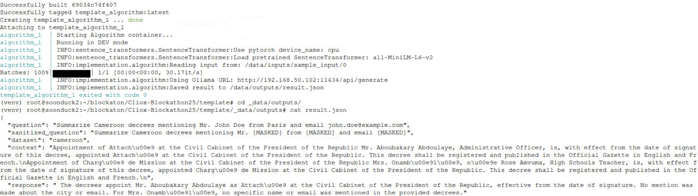
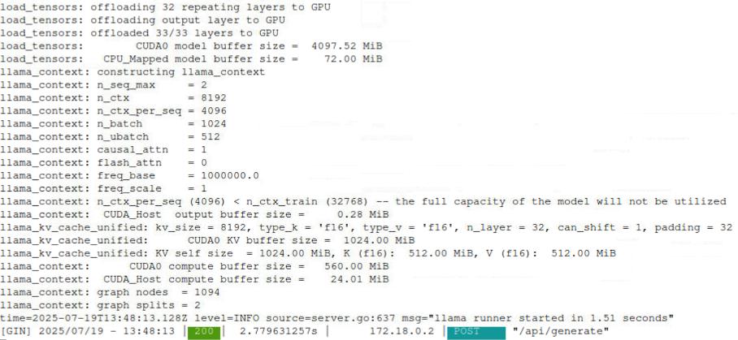
Experimental Results & Testing Scenarios - Local
Privacy Masking Example
Input Query:
"Summarize Cameroon decrees mentioning Mr. John Doe from Paris and email john.doe@example.com"
Multiple privacy scenarios tested using inputs containing sensitive information across different entity categories.
PERSON and GPE masking were successfully processed by spaCy NER component with high accuracy.
EMAIL masking required regex enhancement to complement spaCy NER for complete coverage.
After Masking:
"Summarize Cameroon decrees mentioning Mr. [MASKED] from [MASKED] and email [MASKED] "
Entity Detection Results
Results are stored in /data/outputs/result.json for secure further processing by Clio-X, maintaining the Web3-native privacy preservation chain.
PERSON: "John Doe"
Successful
GPE: "Paris"
Successful
Our Algorithm
EMAIL: "john.doe@example.com"
Regex Enhanced
Ollama (External)

Slide 8
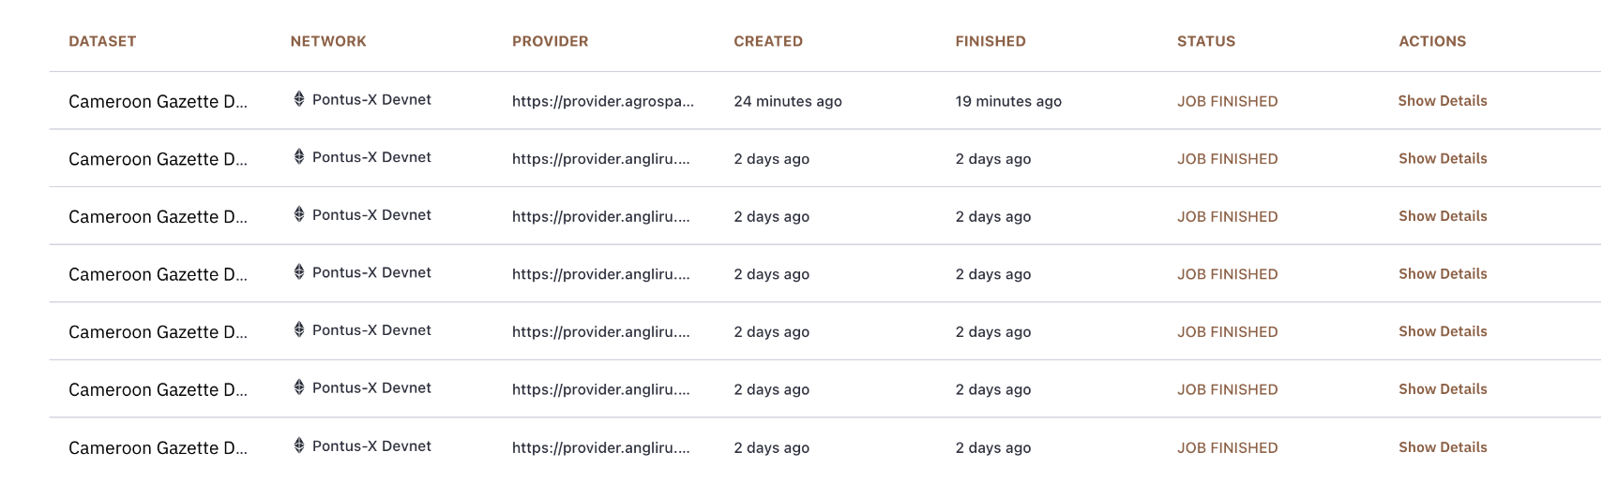
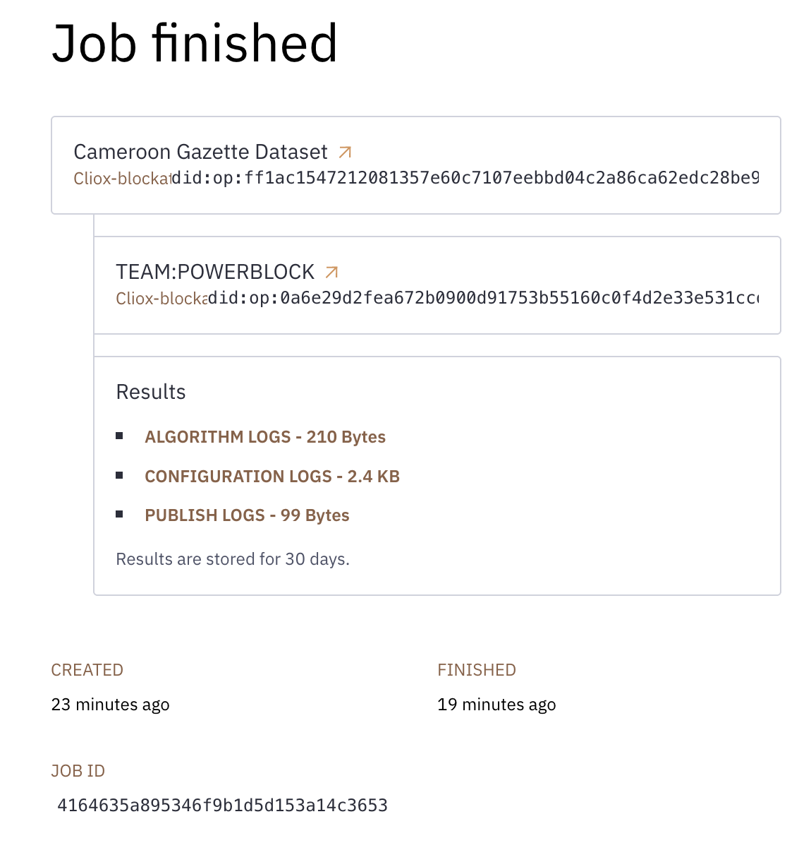
Experimental Results & Testing Scenarios – Clio-X

Slide 9
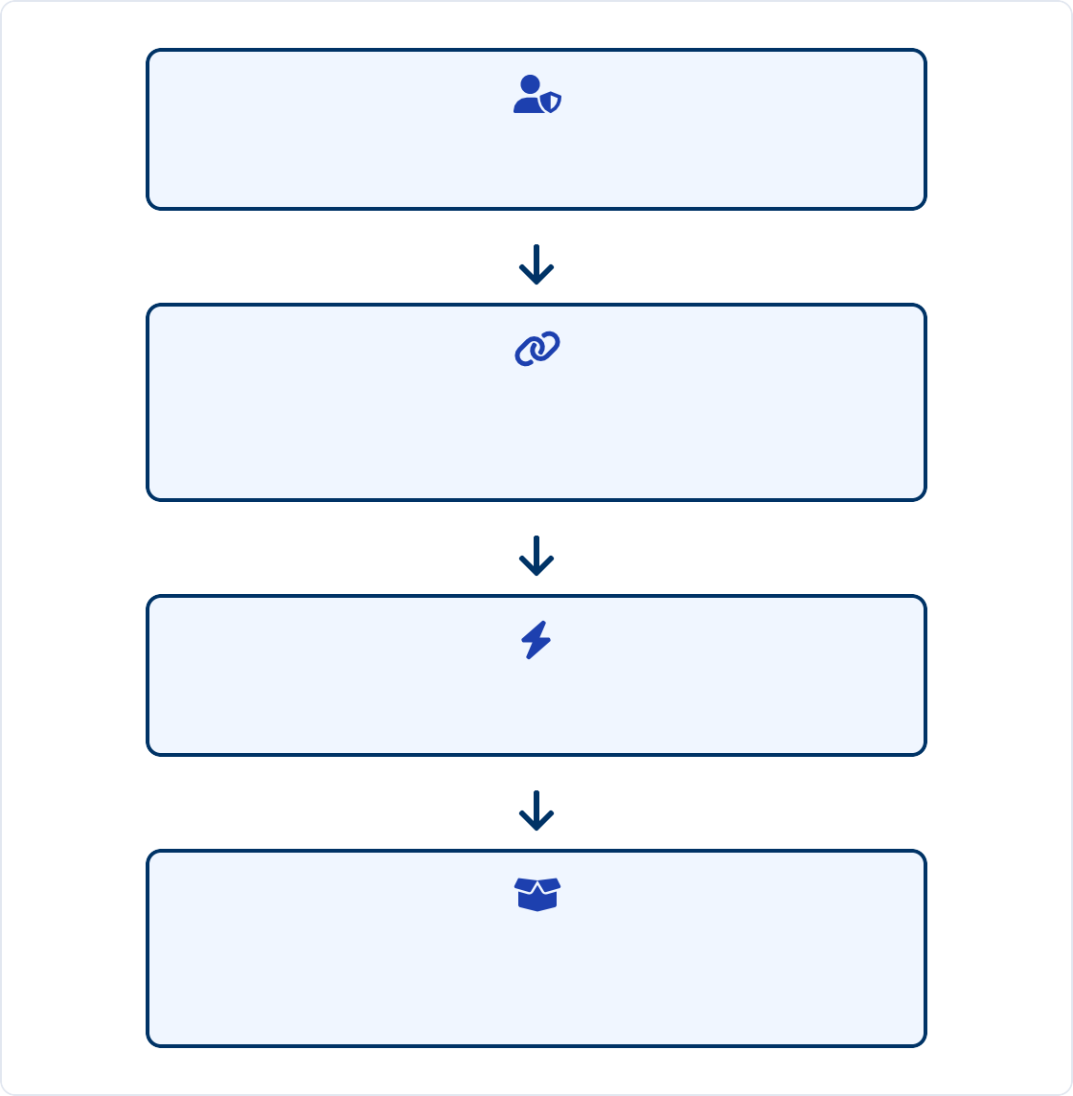


Web3-Native Integration & Data Provenance
DID-based authentication and on-chain data verification integrated via Clio-X APIs.
User with DID (did:ethr:0x...)
Docker Compose enables on-demand algorithm service execution triggered by Clio-X events.
Blockchain Verification
Validates data ownership
Data provenance and complete auditability guaranteed throughout the processing pipeline.
"Web3-native integration ensures that every AI interaction is verifiable, traceable, and user-controlled, maintaining the core principles of decentralized applications."
Clio-X Event Triggers
Algorithm Container Activation
/data/inputs → /data/outputs

Slide 10
Technical Contributions
Web3 Integration with Privacy-by-Design
Implementation of DID-based authentication and data ownership verification through Clio-X platform, ensuring complete user control over personal data.
1
Trust Boundary Separation
External Ollama LLM server maintained as independent service, creating a clear security boundary between Web3 infrastructure and AI processing components.
2
Automated Sensitive Entity Masking
Fully automatic detection and masking of all sensitive information (PERSON, EMAIL, GPE) through combined NER and regex approaches before external processing.
3

Slide 11


Future Work & Extensions
Multilingual expansion to support diverse global Web3 communities beyond English-centric interfaces.
On-chain AI service integration for fully decentralized, transparent AI execution with smart contract governance.
Multilingual Support
Cross-language privacy preservation with culture-specific entity recognition
On-chain AI Services
Blockchain-verified AI execution with decentralized governance
Enhanced privacy protection through differential privacy techniques to further prevent information leakage.
Scalability improvements for Web3-Enterprise and public Web3 service applications.
Differential Privacy
Advanced statistical techniques to prevent inference attacks
Enterprise Scalability
High-throughput architecture for organizational Web3 adoption
"The future roadmap aims to establish this framework as the standard for privacy-preserving AI systems in decentralized environments."

Slide 12

Conclusion
Demonstrated a robust framework for privacy-preserving AI chatbots in Web3, addressing critical needs in post-pandemic digital transformation.
Clio-X integration ensures user control, auditability, and native Web3 compatibility through decentralized identity verification and blockchain validation.
Sets the foundation for secure, privacy-aware conversational AI in decentralized ecosystems with potential applications in Web3- Enterprise and public services.

Slide 13
Thank You
Questions?

